Slide 1

CSE 583
Software Design for Data Scientists Course Introduction & validating software
Bryna Hazelton^{1,5}, David Beck^{1,2,3,4},
Elli Beres^{3,6}, Ian Quah⁷
¹eScience Institute
²Chemical Engineering
³Computer Science
⁴Environmental & Occupational Health Sciences
⁵Physics
⁶Seattle Hub for Synthetic Biology,
⁷Psychology
University of Washington
September 25, 2025

Slide 2
What's the class about? Who are we?
Instructor introductions
Objectives
Teach how to create and collaborate on data- and computation-intensive research projects
Provide practical software engineering skills for data analysis in research & industry
Elevate coding in academia to the level of technical / manuscript writing and patents

Slide 3
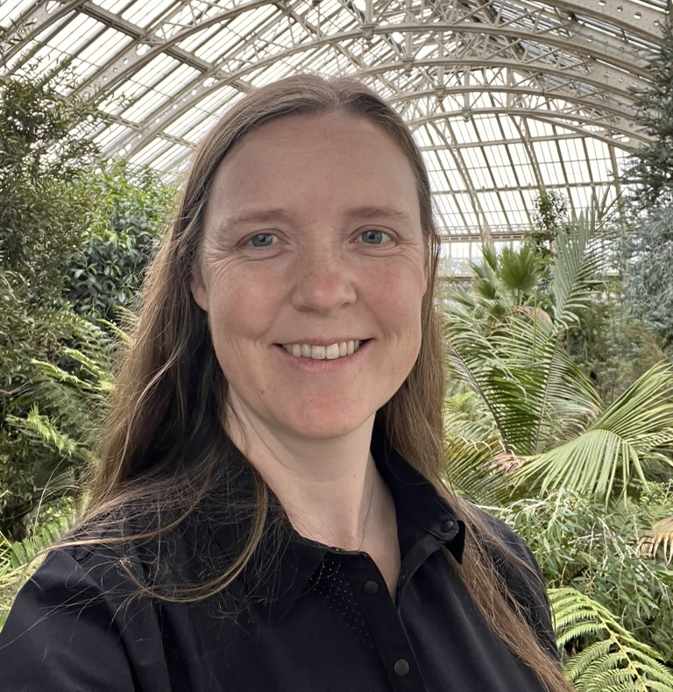
Bryna Hazelton
Astrophysics, specifically studying the early universe with radio telescopes
Petabyte scale data analysis (software)
Develop open-source software packages used widely in radio astronomy
eScience Director of Research Programs
Love gardening, particularly edible things
Email: brynah@uw.edu

Slide 4

Ian Quah
3rd year PhD trainee in Psychology
I study how structure and function mutually constrain one another in the d melanogaster via computational methods
Before coming back to school, I worked in cryptography and machine learning
I enjoy (indoor) bouldering and making kimchi and yogurt

Slide 5

Elli Beres
2nd year graduate student in Computer Science & Engineering
Research synthetic biology with Dr. Sudarshan Pinglay at UWGS and the Seattle Hub for Synthetic Biology
Love weightlifting, playing soccer, hiking, sci-fi and fantasy, and GMing and playing TTRPGs

Slide 6
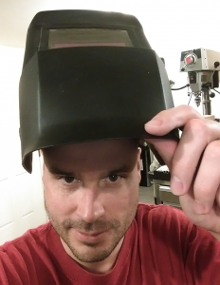
Dave Beck
I’m Dave, not Dr. Beck, or Professor Beck

Slide 7
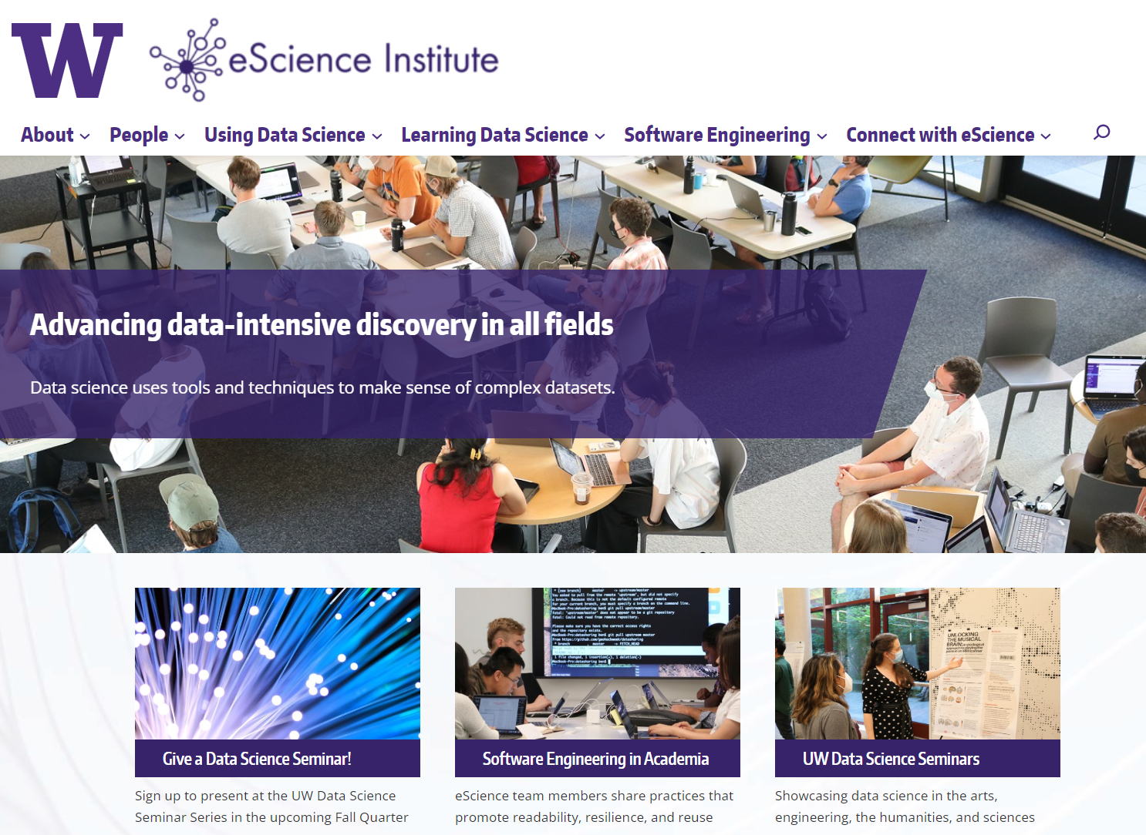

Slide 8
Agenda
Why data science?
Course overview
Validating your software install
8

Slide 9
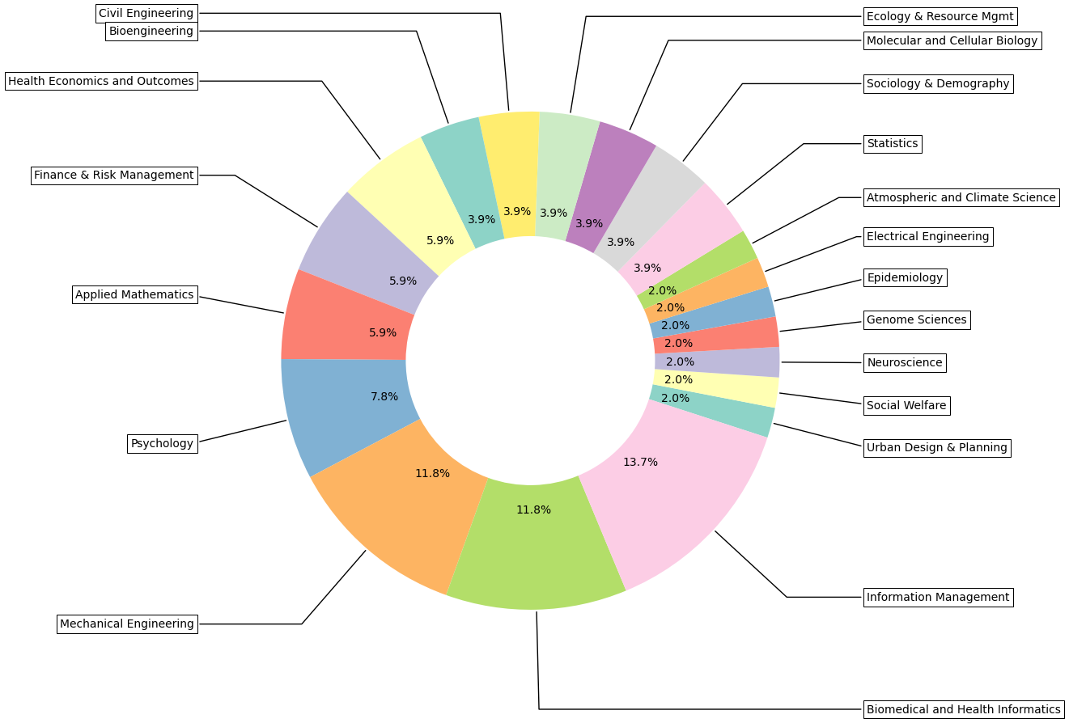
Course Registration by Field of Study

Slide 10
Course Overview
10

Slide 11
Survey Results (21/51 responding)
Most are comfortable (in some language) with:
Hello world, if statements, for statements, writing functions, reading data from a tab-delimited file, importing a library and producing a plot
About half are comfortable (in some language) with:
Writing a docstring and training a statistical model
Few are comfortable with:
Scraping a web page, working with >1 TB of data, developing a complex app or module
About half have never used git, most who have used it feel that they are beginners

Slide 12
What you will learn
Program in Python using the Python scientific stack, including numpy, pandas, and matplotlib.
Search, evaluate, and integrate into a project externally developed Python packages; create your own Python packages.
Develop unit tests that validate important aspects of the project implementation.
Develop software that it can be used by others including: sharing code on GitHub, documentation, installing packages, setup, and running computational studies.
Create technical specifications for what a program should do and how this is accomplished.

Slide 13
Course Structure
http://uwseds.github.io/syllabus.html
Programming basics
Version control, Python, data manipulation
Software development
Debugging, documentation, design, collaboration
Enrichment?
Visualization, machine learning
Software engineering practicum (project)

Slide 14
Programming vs. Software Engineering
Analogy: What is the difference between the following kinds of writing:
Note to yourself
An article in the NY Times
14

Slide 15
Relating Writing to Software
How Learn Skills
Reporter
Writing quality
Content
Structure
Review
SW Eng
Code quality
Features
Design
Testing
Programming course, this class
Freshman English
{
{
Composition & literature classes, professional writer
CS degree, practical collaborative exp., this class
15

Slide 16
Grading
Item | %
Homework (~5 homeworks) | 35
Class participation | 15
Class project | 50
16
Notes:
Describe the importance of the homework and address concerns about rigidity for grad students

Slide 17
Grading
How we grade homework…
You submit homework using GitHub (version control tool) by the due date
We take up to a week to review the homework and give feedback with a GitHub Issue
You have an additional week to revise the homework to address any weaknesses
Your final grade for a homework is given
There is no reason you can’t get 5/5 on all HW
17
Notes:
Describe the importance of the homework and address concerns about rigidity for grad students

Slide 18


GitHub & Version Control
Version control is an essential tool in software engineering. It is “track changes” for code.
We use GitHub to collect and give feedback on homework.
The world uses GitHub to co-develop software. You will learn git and GitHub.
18

Slide 19
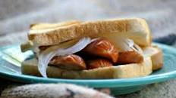
GitHub & Version Control
We sent out a data collection instrument to map your UW NetID onto your GitHub account.
Right now…. A hot dog is a sandwich by popular vote.
19

Slide 20
Class project overview
Collaborative software engineering experience
Teams of 3 to 4 with 4 being optimal
Prefer teams with diversity
Develop project using version control
20

Slide 21
Class project overview
Collaborative software engineering experience
Design (use cases, component specification)
Documentation (how to, docstrings)
Style (PEP8, pylint)
Coding, testing & milestones
Standup & code reviews
http://uwseds.github.io
21

Slide 22
Project Type 1:
Answer “Research” Questions
Problem statement: Answer two to three questions of business or scientific relevance
Use a Jupyter notebook and supporting python files
Example
Connect the Dots: Predicting HIV viral load using new low-cost testing techniques
22

Slide 23
Capstone Project Type 2:
Create Reusable Data
Problem statement: Create data repository with tools (e.g., search, visualization, analytics)
Example
PyWRIS: Make India Water Resource Information available to reusable python code.
23

Slide 24
Project Type 3:
Create a Tool
Problem statement: Solve a problem common to many users
Don’t re-invent the wheel
Example
MoSnoPro-US – Modeling and visualization for snow-pack properties to make model data accessible to non-experts
24

Slide 25
Getting Started
Students present statements of interest
Gather with like minded students
Verify the project idea
Size the effort

Slide 26
Things to Think About
Topics of interest
Is there an unmet need (i.e. no code already exists)?
Is there only commercial software available for a task?
What is the potential user base?
Data you have access to NOW
How much you’ve used the data
Code you have to access the data
How clean the data are
26

Slide 27
Verify the Project Idea
Is there an unmet need (i.e. no code already exists)?
Clarity about the project type?
Consensus on the problem being solved.
Do you have data that can solve the problem?
27

Slide 28
More on the Data
At least two non-trivial data sets
Data need to be combined, joined, merged, etc. to answer the scientific questions
Have access to the data NOW!
28

Slide 29
Some Public Data
http://drugbank.ca
http://toxnet.nlm.nih.gov
https://data.seattle.gov/Transportation/Traffic-Flow-Counts/7svg-ds5z
https://www.divvybikes.com/data
http://www.nyc.gov/html/tlc/html/about/trip_record_data.shtml
https://www.kaggle.com
Pronto bike data
American Fact Finder Data
European union data (World bank)
Russian federation data (World bank)
China data (World bank)
29

Slide 30
Data! Data! Data!
At least two non-trivial data sets
Data need to be combined, joined, merged, etc.
Think about your data NOW!
30

Slide 31
Project Ideation
Over the first few weeks
What areas are you interested in? E.g. social good or a job demo.
What data are available in that space?
What tools already exist in that space?
What type of project is this? (answer research question, create reusable data, create a tool, other?)
Volunteer to give a one slide, 5 minute project idea pitch at the start of class!
31

Slide 32
Course Web Page
http://uwseds.github.io
32

